Slide 1
ESP 46W
Female Connector Assy

Slide 2
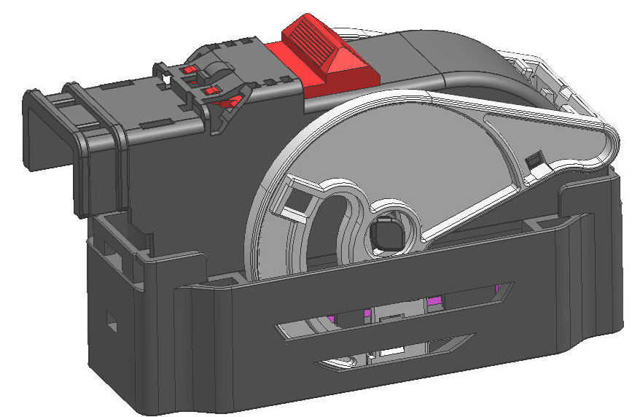
ESP 46W Female connector
  Standard interface and compatible to the competition
  Small size, more compact design(slider inside female housing, and block seal adoption)
  High performance terminal
  Simplified manufacture and assembly process (pre-assembly lever cover)
  High IP code (high pressure spray IP 9K)
  Low connector mating force (below 75N)
  Secondary connector lock (CPA)
46 Way ESP Connection

Slide 3
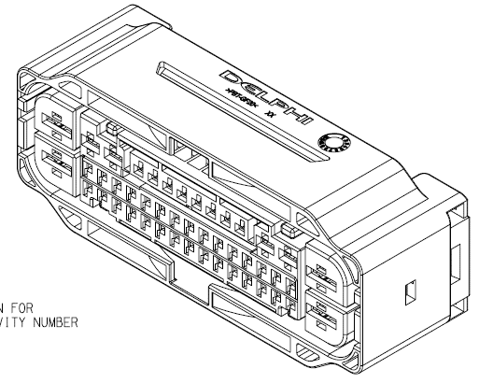
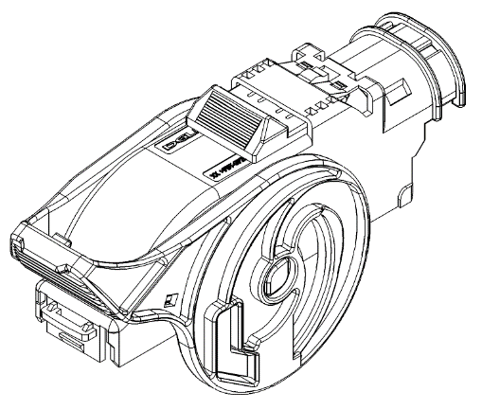
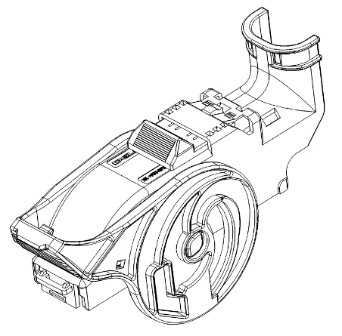
ESP 46W Female connector
Description | PIC | PN | Description | M. Site | Drawing NO.
Female connector housing |  | 33222138 | all cavity open | China | 33120566_CUS01_S01.pdf
 |  | 33222139 | not all cavity open | China
 |  | 33222140 | not all cavity open | China
 |  | 33376010 | not all cavity open | China
Cover |  | 33326011 | Horizontal | China | 33337666_CUS01_S01.tiff
 |  | 35235634 | Vertical | China
There is only one Code 0 which can cover each Code for housing.

Slide 4
ESP 46W Female connector
Title | Terminal PN | M. Site | Plating | Drawing NO. | Wire Size Range(mm2) | Cable Seal PN | M. Site | Drawing NO. | Cavity Plug PN | M. Site | Drawing NO.
Female Terminal OCS 120 | 35072402 | China | Sn | 13543112_CUS01_S07.pdf | 0.13~0.22mm^2 | Mat seal | N/A | N/A | 13963810 | China | 13963810_CUS01_S01.tiff
 | 35072403 | China | Sn |  | 0.35~0.50mm^2
 | 35072404 | China | Sn |  | 0.75~0.8mm^2
 | 35072405 | China | Sn |  | 0.8~1.0mm^2
 | 35072406 | China | Sn |  | 1.25~1.5mm^2
Female Terminal CTS 280 | 15446673 | EU | Sn | 15446676_CUS02_S01.pdf | 0.35mm2 | 15327860(1.2-2.0mm) | Korea | 15446589_CUS53_S01.tiff | 15337197 | EU | 13688485_CUS51_S01.pdf
 | 15446674 | EU | Sn |  | 0.5-1mm2 | 15327863(2.0-2.7mm) | EU
 | 15446675 | EU | Sn |  | 1.5-2.5mm2 | 15327859(2.7-3.0mm) | EU
Female Terminal CTS 480 | 13976114 | EU | Sn | 13976112_CUS01_S01.pdf | 0.35mm2 | 15363779(1.2-2.0mm) | EU |  | 12066082 | NA | 12124630_CUS01_S01.pdf
 | 13976115 | EU | Sn |  | 0.5-1.0mm2
 | 13976116 | EU | Sn |  | 1.5-2.5mm2 | 15363604(2.0-2.7mm) | EU
 | 13976117 | EU | Sn |  | 2.5-4mm2 | 15327864(2.8-3.8mm) | EU
 | 13976118 | EU | Sn |  | 4-6mm2 | 15363605(4.0-4.5mm) | EU

